Slide 1
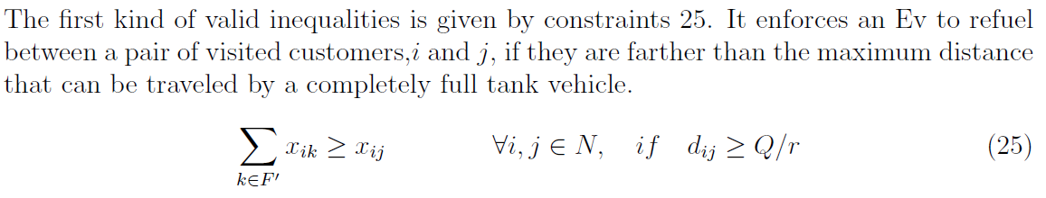
Methodology (third step)
Valid inequalities for EVRP models
First valid inequality (from Bruglieri et al., (2019)):

Slide 2
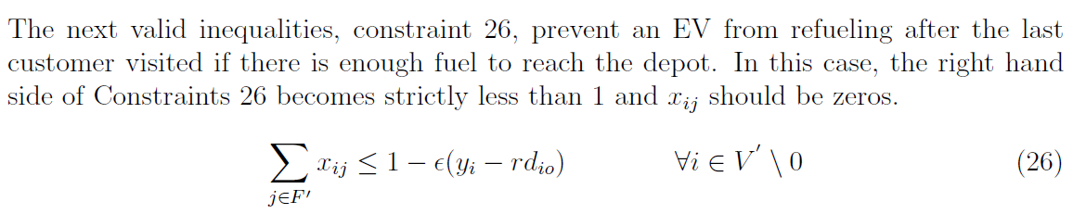
Methodology (third step)
Valid inequalities for EVRP models
Second valid inequality (from Bruglieri et al., (2019):
* Decision variable $y_{i}$ is equal to $l_{i}$ in our model.

Slide 3
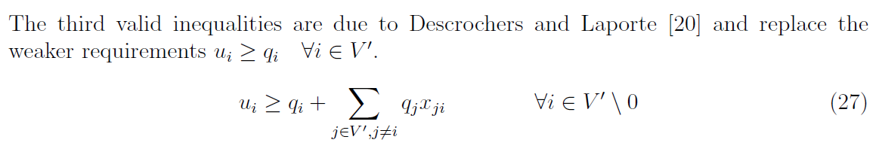
Methodology (third step)
Valid inequalities for EVRP models
Third valid inequality:

Slide 4

Methodology (third step)
Valid inequalities for EVRP models
Fourth valid inequality (from Yaman, H. (2006)):
$\sum_{i∈N∪F^{′}}{a_{i}≥\left\lceil \frac{\sum_{i∈N}{q_{i}}}{Q}\right\rceil }$
Number of last nodes in trips should be selected to meet demands while satisfying the capacity of the vehicle

Slide 5
Computational results
Comparison of four MILP models on various instances (without valid inequalities):
All four MIP models have been coded by Python using a 1.60 GHz Intel® Core i5 processor with 16 GB RAM.
We solved MIP models over small size instances (up to 10 nodes in the distribution system), medium-size (up to 15 nodes in the distribution system), and large-size (up to 121 nodes in the distribution system).
The criteria are Best Objective Function (BOF) and run times.
The execution time is limited in 10 sec for large instances.

Slide 6
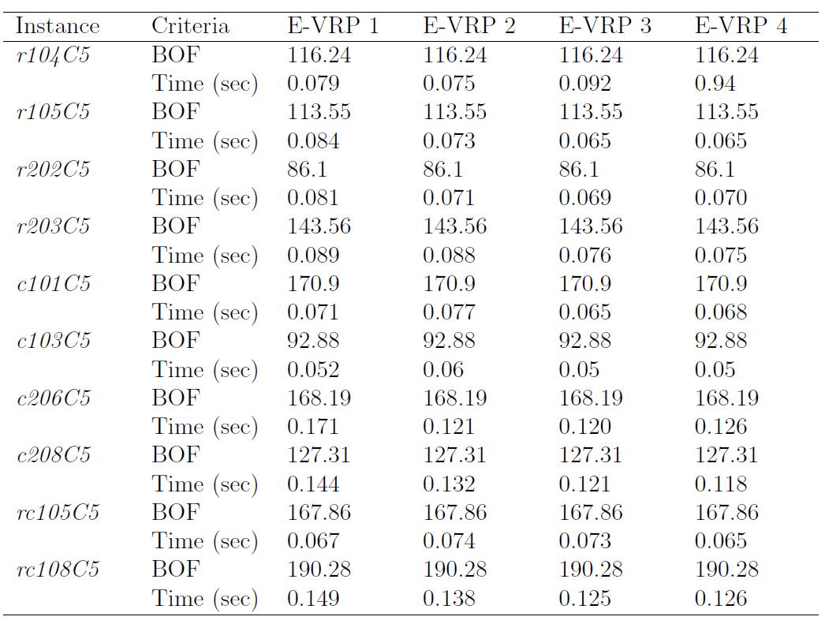
On small instances:

Slide 7
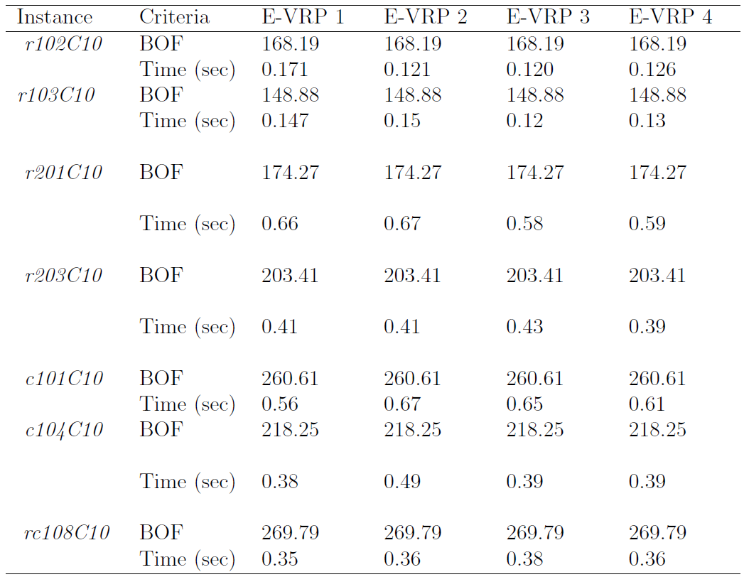
On medium instances:

Slide 8
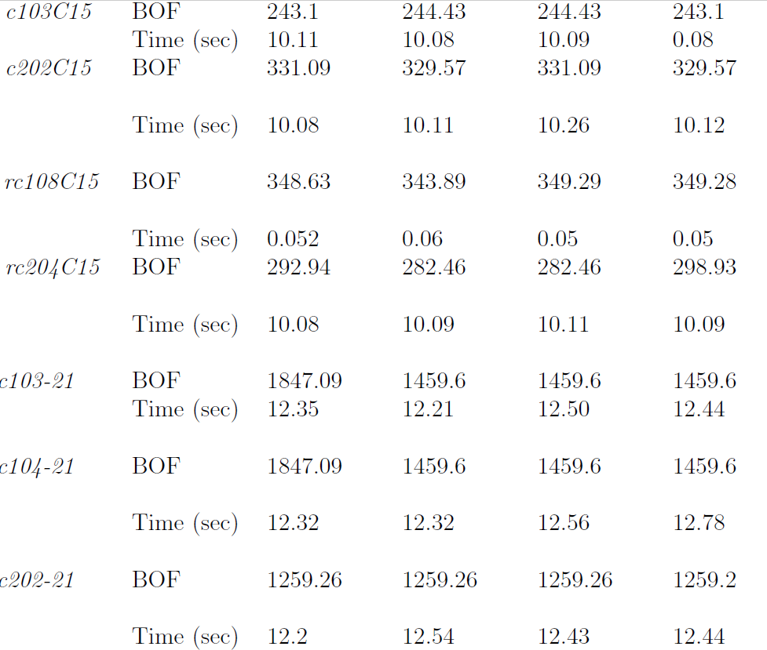
On large instances:

Slide 9
Computational results
Investigation of the presented valid inequalities efficiency
All MIP models with valid inequalities have been coded by Python using a 1.60 GHz Intel® Core i5 processor with 16 GB RAM.
Valid inequalities 1 to 4 are added to all 4 models
Valid inequality 4 is added to models 2 to 4.
The criteria are run times, number of explored nodes on B&B tree and LP bound.
The execution time is limited in 10 sec.

Slide 10
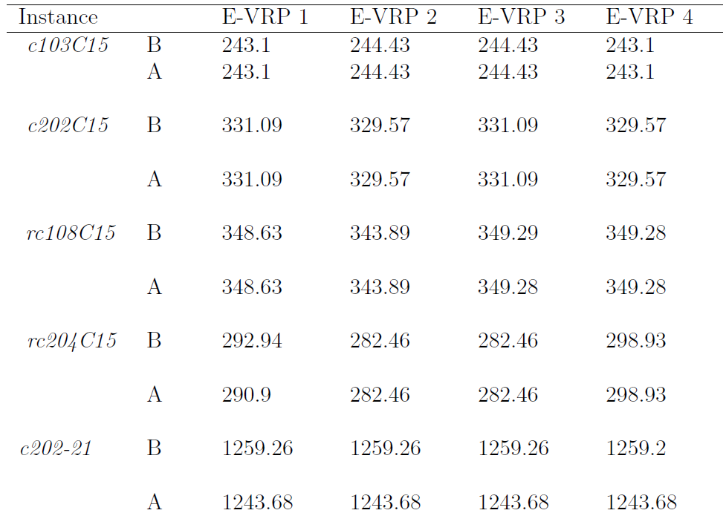
First valid inequality:

Slide 11
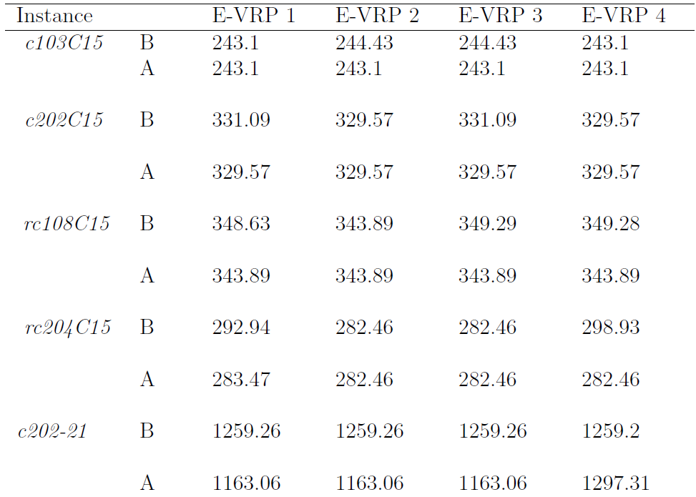

Second valid inequality:

Slide 12
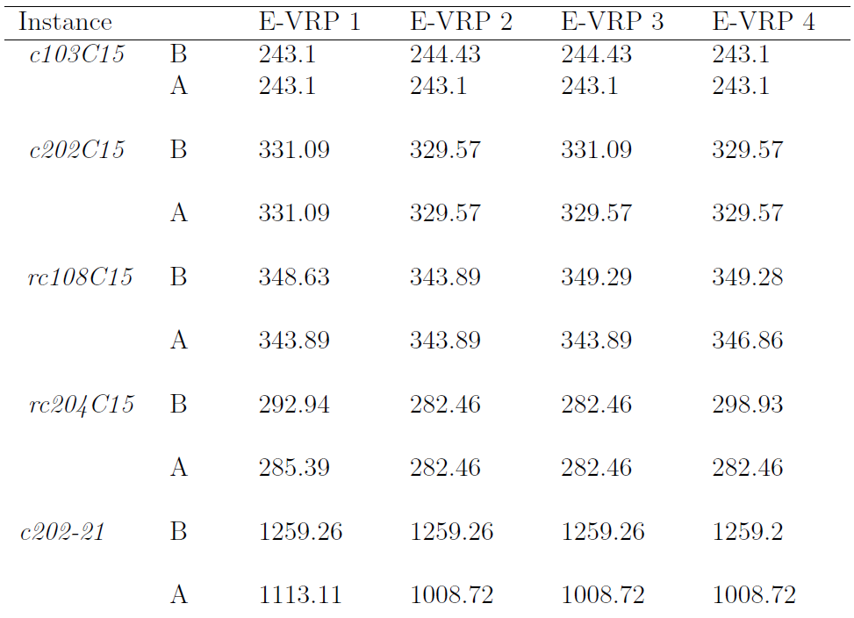
Third valid inequality:

Slide 13
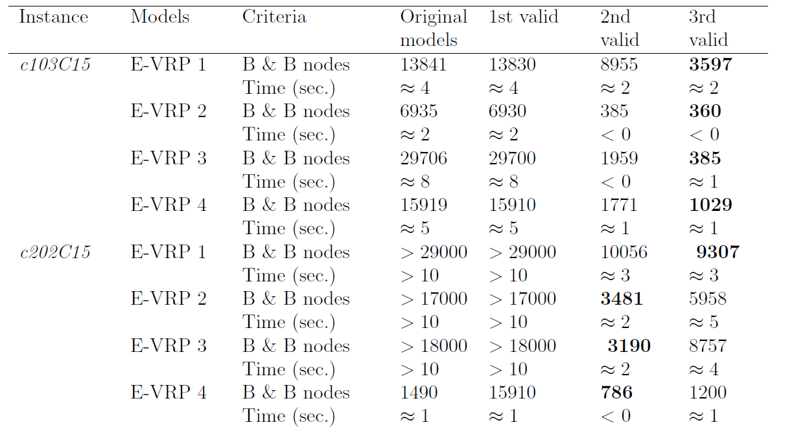
Comparison of first three valid inequalities

Slide 14
LP bounds after adding fourth valid inequalities to MIP models 2-4
IP solution | instance |  | EVRP2 | EVRP3 | EVRP4
1646.81 | c101_21 | B: before adding | 458.39 | 458.39 | 458.39
 |  | A: after adding | 642.38 | 642.38 | 642.38
 |  | Imp. | 15% | 15% | 15%
952.22 | c201_21 | B | 542.77 | 542.77 | 542.77
 |  | A | 556.26 | 556.26 | 556.26
 |  | Imp. | 3% | 3% | 3%
343.89 | rc108C15 | B | 159.18 | 159.18 | 159.18
 |  | A | 162.98 | 162.98 | 162.98
 |  | Imp. | 2% | 2% | 2%
243.1 | c103C15 | B | 140.87 | 140.87 | 140.87
 |  | A | 142.12 | 142.12 | 142.12
 |  | Imp. | 1% | 1% | 1%

Slide 15
LP bounds after adding all valid inequalities to MIP models 2-4
IP solution | instance |  | EVRP2 | EVRP3 | EVRP4
1646.81 | c101_21 | B | 458.39 | 458.39 | 458.39
 |  | A | 658.03 | 658.03 | 658.03
 |  | Imp. | 17% | 17% | 17%
952.22 | c201_21 | B | 542.77 | 542.77 | 542.77
 |  | A | 556.26 | 556.26 | 556.26
 |  | Imp. | 3% | 3% | 3%
343.89 | rc108C15 | B | 159.18 | 159.18 | 159.18
 |  | A | 162.98 | 162.98 | 162.98
 |  | Imp. | 2% | 2% | 2%
243.1 | c103C15 | B | 140.87 | 140.87 | 140.87
 |  | A | 142.12 | 142.12 | 142.12
 |  | Imp. | 1% | 1% | 1%

Slide 16
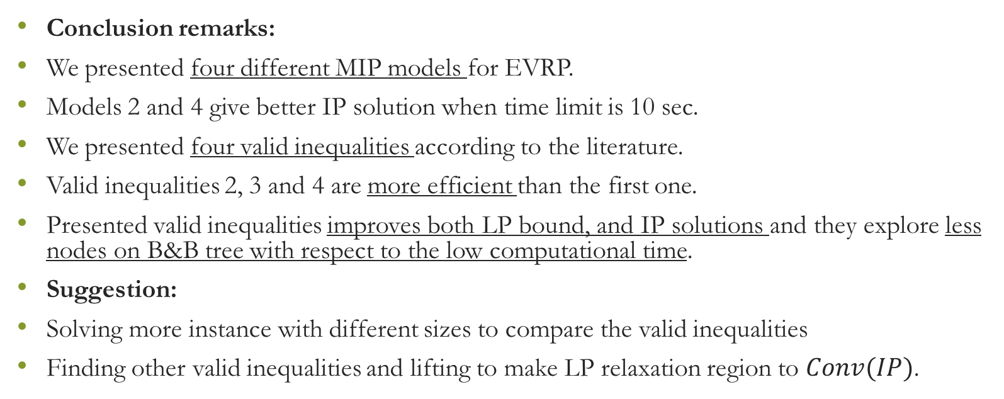
Conclusion & suggestions for future studies
Conclusion remarks:
We presented four different MIP models for EVRP.
Models 2 and 4 give better IP solution when time limit is 10 sec.
We presented four valid inequalities according to the literature.
Valid inequalities 2, 3 and 4 are more efficient than the first one.
Presented valid inequalities improves both LP bound, and IP solutions and they explore less nodes on B&B tree with respect to the low computational time.
Suggestion:
Solving more instance with different sizes to compare the valid inequalities
Finding other valid inequalities and lifting to make LP relaxation region to $Conv(IP)$.

Slide 17


