Slide 1


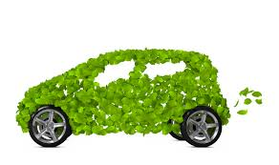

"Mixed-Integer Programming
Formulations and Valid Inequalities for Electric Vehicle Routing
Problem"
Arghavan Sharafi & Nima Moradi

Slide 2
Outline
Introduction
Literature review
Problem description
Four different Electric Vehicle Routing Problem Formulations:
Three formulations based on Miller-Tucker-Zemlin constraints
A formulation based on flow
Valid inequalities
Computational Experiment
Make comparison between models
Valid inequalities efficiency
Conclusion
Reach better feasible solutions in a shorter run time and less explored nodes of Branch & Bound (B&B)
Tighten the feasible region of LP relaxation problems and find better LP bounds

Slide 3
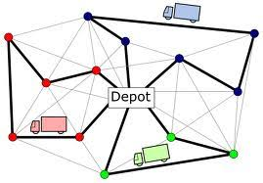
Introduction
For many years, a distribution system has focused on the minimization of the cost of a system
Min. the cost total traveled distance
Vehicle routing problem
The environmental effect of distribution systems, absorbs great attention
As a result, many companies start to use Electric vehicles to respond to new concerns
Vehicle routing problem

Slide 4
Challenges
The limited driving range of Electric Vehicles
Lack of infrastructure for Electric Stations (AFSs)
Electric vehicles have to visit Electric Stations whenever they need ( many times in their route planning)
VRP+EVs=EVRP

Slide 5
Electric vehicle routing problem
Erdogan and Miler-Hooks (2012)
Green Vehicle Routing Problem
A Mixed-Integer-Linear Programming formulation and two heuristics to solve the problem
Schneider et al., (2014)
Electric Vehicle Routing Problem with Time Windows and Recharge Stations
Mixed-Integer-Linear Programming formulation and solved the problem with a hybrid metaheuristic combining variable neighborhood search and tabu search
Jun Yang and Hao Sun (2015)
Determine the location of fuel stations and the routing plan of a fleet of EVs to minimize the total travel distance
Merve Keskin et al. (2019)
Considering time-dependent queueing times at the stations.
A Mixed-Integer-Linear Programming formulation and a evolutionary Algorithm
Selected literature

Slide 6
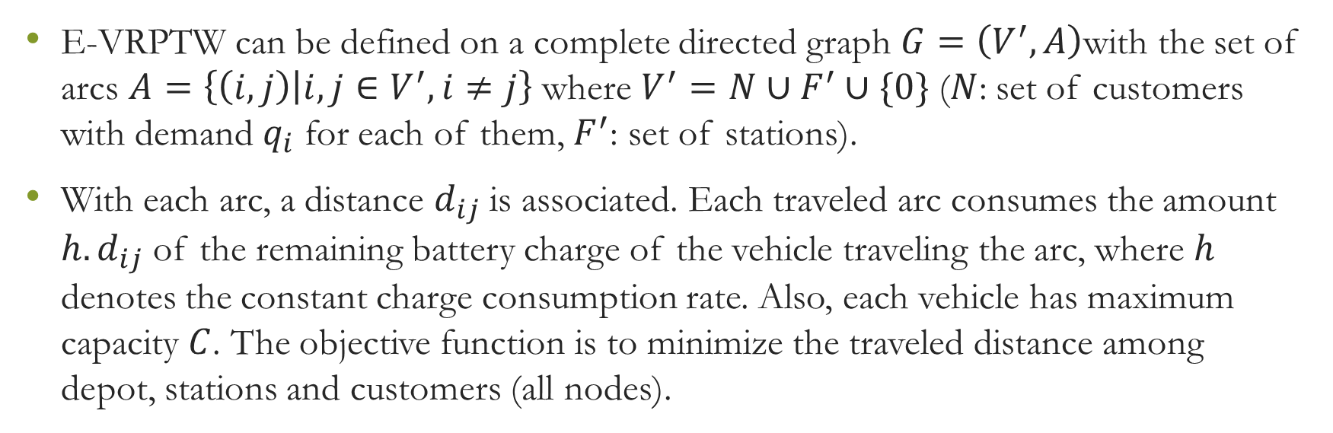
Methodology (first step)
Problem description (Electric-Vehicle Routing problem)
E-VRPTW can be defined on a complete directed graph $G=\left(V^{′},A\right)$with the set of arcs $A=\left\{\left(i,j\right) | i,j∈V^{′},i≠j\right\}$ where $V^{′}=N∪F^{′}∪\{0\}$ ($N$: set of customers with demand $q_{i}$ for each of them, $F^{′}$: set of stations).
With each arc, a distance $d_{ij}$is associated. Each traveled arc consumes the amount $h.d_{ij}$ of the remaining battery charge of the vehicle traveling the arc, where $h$ denotes the constant charge consumption rate. Also, each vehicle has maximum capacity $C$. The objective function is to minimize the traveled distance among depot, stations and customers (all nodes).

Slide 7
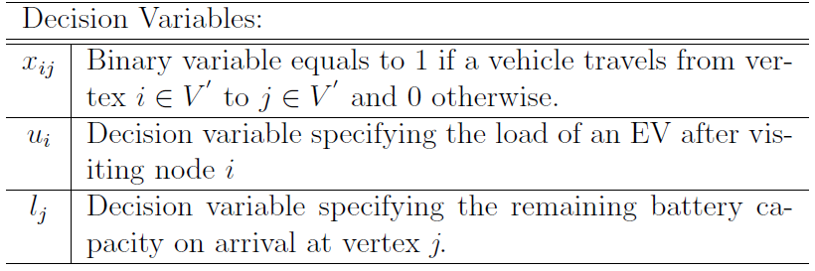
Methodology (second step)
Different MIP formulations for EVRP
First mathematical model (based on Miller-Tucker-Zemlin constraints):

Slide 8
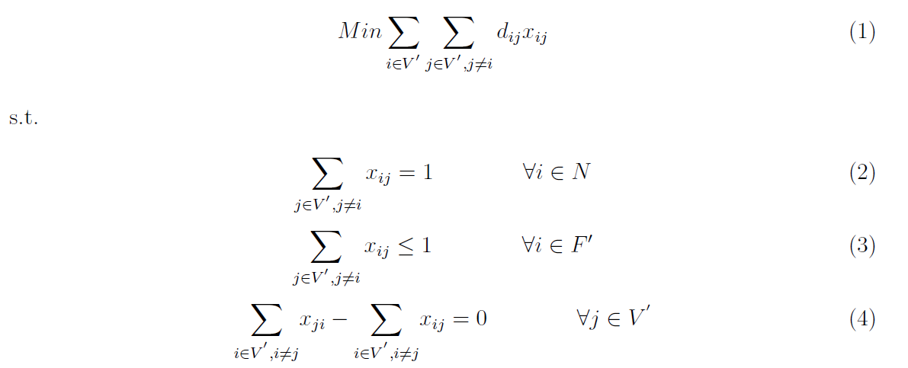
Methodology (second step)
Different MIP formulations for EVRP
First mathematical model (based on Miller-Tucker-Zemlin constraints):

Slide 9
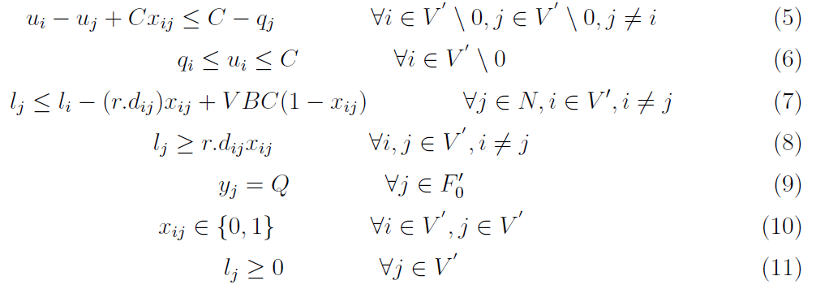
Methodology (second step)
Different MIP formulations for EVRP

Slide 10
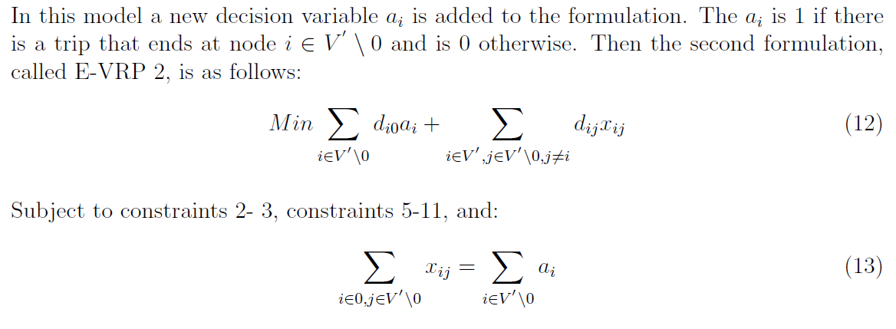
Methodology (second step)
Different MIP formulations for EVRP
Second mathematical model:

Slide 11
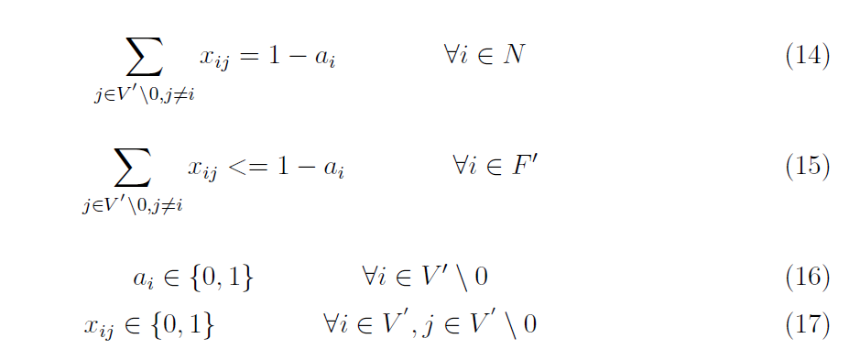
Methodology (second step)
Different MIP formulations for EVRP
Second mathematical model:

Slide 12
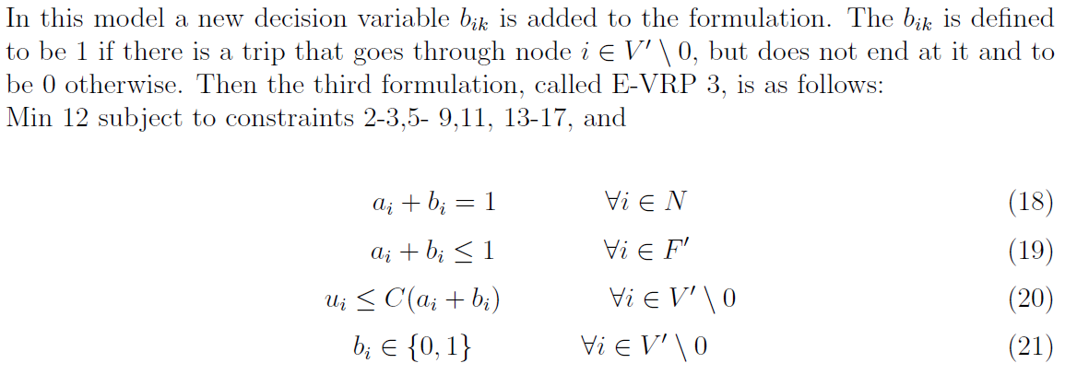
Methodology (second step)
Different MIP formulations for EVRP
Third mathematical model:

Slide 13
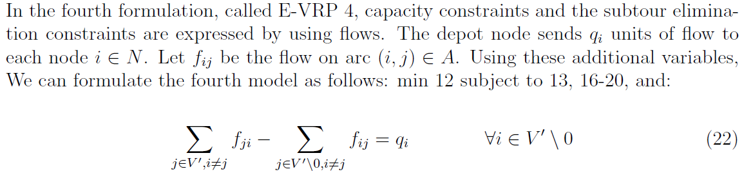
Methodology (second step)
Different MIP formulations for EVRP
Fourth mathematical model (based on flow):

Slide 14
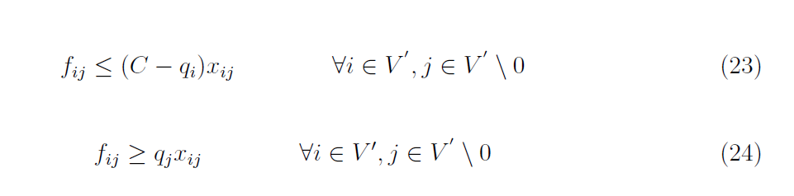
Methodology (second step)
Different MIP formulations for EVRP
Fourth mathematical model (based on flow):

